Slide 1


History GCSE
Revision Timetable 2024-25
7 revision items on average
per week, if you are starting now. Any order is fine providing you keep a check list.
Many will have already be able to mark off and revisit resources they have prepared previously.
In here you will find a step-by-step guide to planning your revision for both History and other subjects. At the time of receiving this there is approximately 24 weeks left until your History exams begin. I have left off 1 week over Christmas and identified your holidays by highlighting the background in grey. The two examinations you will be sitting are as follows;
Paper 1 – USA/WW1 – Thursday 16th May 2025 (AM)
Paper 2 – H&P/Elizabeth – Thursday 5th June 2025 (AM)
This document is available on www.historyis.net
There is also a blank version on there for those people who may prefer to rearrange the content or reprint if needed
Please make use of this booklet to keep a track of your work, some of which you may have completed already. As you read how to use this timetable, please pay attention to how it is supposed to work and some possible revision strategies
It is the best we can do to provide you with a structure and materials available to help you organise.
Possible revision resources:
Your exercise books (assuming they are organised)
Teams (your lessons will be in your class Team)
www.historyis.net (revision booklets / videos)
Quizlet (see barcodes beneath)
Other AQA focused History revision websites you find
QR code for Quizlet revision cards (understanding and knowledge)
QR code for Quizlet key terms cards

Slide 2



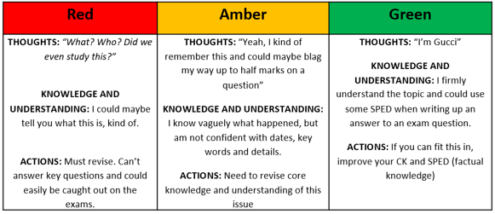
How to make the best use of your History revision timetable​
​
​
Before we begin, here are a few things you need to consider before you start using it. This revision schedule is designed to be almost complete by the time revision amplifies in other subjects. The guidance below will help you modify this revision timetable to your needs. If you find that the modifying leaves you with a completely different version, then there is a blank template on www.historyis.net (along with another of the filled one as a reminder)​
​
STEP 1: IDENTIFYING:​
How many subjects will you be sitting exams in? _______ (list them below, including how many exams)​
​
___________________ How many exams in this subject? ______​
___________________ How many exams in this subject? ______​
___________________ How many exams in this subject? ______​
___________________ How many exams in this subject? ______​
___________________ How many exams in this subject? ______​
___________________ How many exams in this subject? ______​
___________________ How many exams in this subject? ______​
___________________ How many exams in this subject? ______​
___________________ How many exams in this subject? ______​
___________________ How many exams in this subject? ______​
___________________ How many exams in this subject? ______​
​
​
STEP 2: PRIORITISING:​
Are there any subjects you feel you might need to spend a bit more time on during revision? For example, are there any that you didn’t do quite so well on in your mocks, or subjects that you are intending to study at A-level?​
​
​
​
​
​
​
STEP 3: TIME MANAGEMENT:​
Do you have any commitments during the week that are going to make revision difficult on some days? For example, if you play football, what time do you play and for how long?​
​
Sunday: ____________________​
Monday: ____________________​
Tuesday: ____________________​
Wednesday: _________________​
Thursday: ___________________​
Friday: _____________________​
Saturday: ___________________
As you guys already know, there are three units that you will be examined on in your History GCSE this year. These are;​​
​​
P1: Section A: America 1920-1973: Opportunity and Equality​​
P1: Section B: Conflict and tension: The First World War 1894-1918 ​​
P2: Section A: Health and the people;c1000 to the present day​
P2: Section B: Elizabethan England, c.1568-1603
​
How to use the table​
The 4 units outlined above are spread over 18 weeks of revision with 6-7 items per week (some bigger, some smaller). There is a 6-week blank page in the final few weeks before exam season to revise the final unit– but keep in mind that ALL subjects will be pressuring you by this point. ​You may want to start revising Elizabeth earlier
​
Use the left column to RAG each item based on the scale below and then, once revised, RAG it to the right. ​
​
​
​
​
​
​
​
​
​
​
2. The top rows tell you the start date of that week (like in your planner) and how many weeks are left until your exams begin. If you get in from school at 3:30pm, give yourself time to chill out and relax before starting work. Rest your brain and start your revision at 4pm. So, your first revision slot might be from;​
​
4.00pm - 4.50pm. Take a ten-minute break after this and start your next revision slot at 5.00pm and study until 5.40pm – if you fancy a second shorter session.​
​
3. It is up to you to decide when and what you will study. The times on the revision timetable are just as an example. If you have football on a Thursday evening at 4.00pm, for example, you can just shade/cross out revision slots then and reschedule them for another day.​
4. Study times at the weekends may be different. You might want to do some work in the mornings instead (your brain is very capable in the mornings), so there are separate time slots for you to fill in here. You can also use the weekends/half terms to catch up from weeks where you were unable to complete the required tasks!​
​
Revision…REMEMBER​
No more than 50 minutes non-stop revision at a time! ​
Don’t overdo it! Revising solidly from 4pm until midnight will exhaust you and your brain! A tired brain can’t learn! Make sure you get plenty of sleep and have a proper break for meals.​
Take a ten-minute break in between sessions; get a drink, stretch your legs and give your brain a break!​
Be proactive! Simply reading notes is no help to you – makes notes, mind map and use colours! Keep your brain busy! Don’t let it switch off!​
Every person is different, so every revision timetable is different – you need to work out what is best for YOU!​
Do NOT let yourself be distracted by unimportant things whilst revising or it doesn’t count. Don’t fool yourself, otherwise you become the fool.

Slide 3
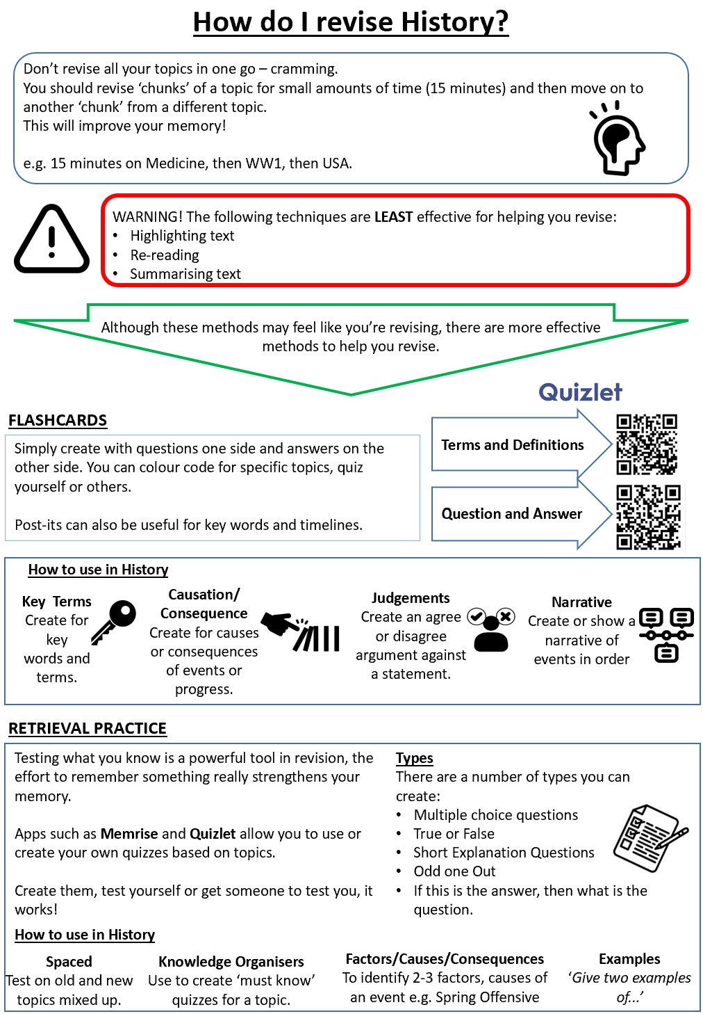
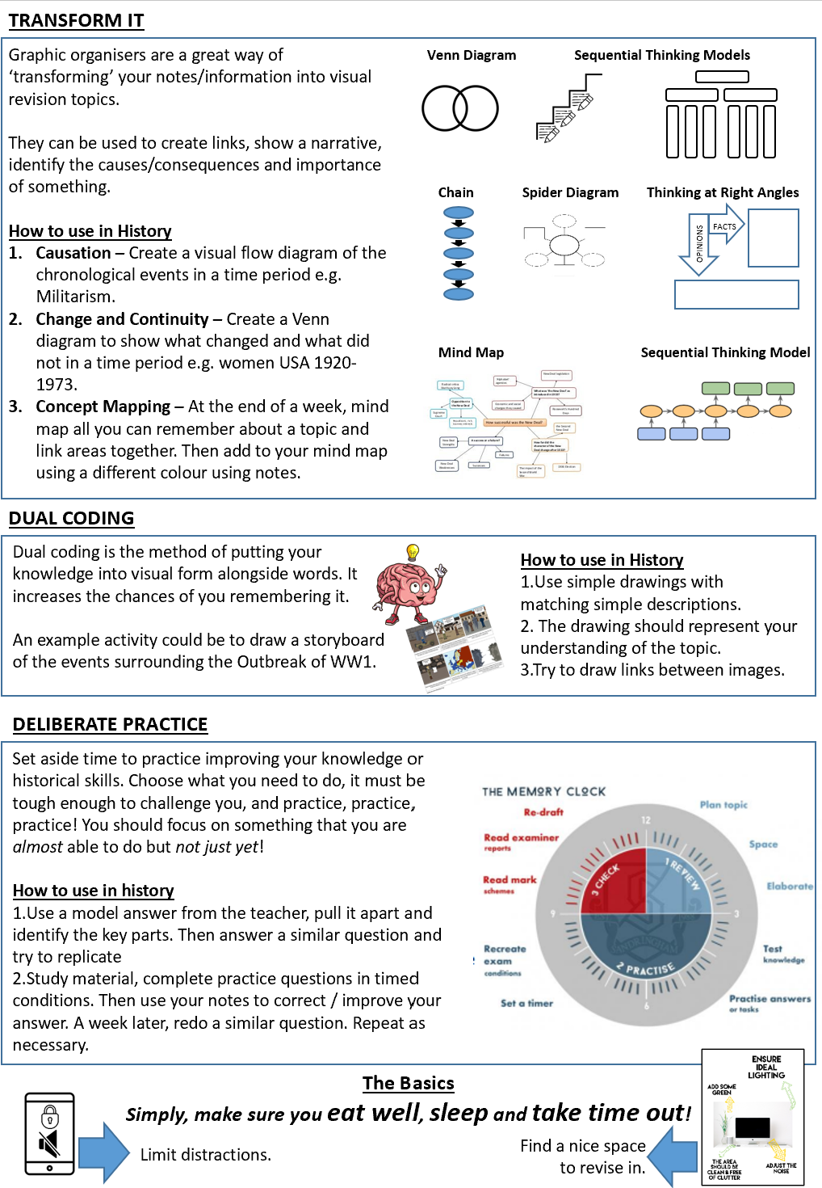

Slide 4
21 weeks to go! | Revision Timetable – PAGE 1 Exam Dates - P1 USA/WW1 – Friday 16th May 2025 (AM) // P2 – H&P/Elizabeth – Thursday 5th June (AM)
 |  | Dec 16th 2024 |  |  | Mon 30th Dec 2024 |  |  | Mon 6th Jan 2025 |  |  | Mon 13th Jan 2025 |  |  | Mon 20th Jan 2025
 | Week 25 | Week 24 |  |  | Week 23 |  |  | Week 19 |  |  | Week 18 |  |  | Week 17
Sunday | This is the week of your parents evening, following your November PPE series What grade did you get? What grade do you want? What materials do you need to get this week to be able to revise with properly? www.historyis.net? Revision guide (CGP or otherwise)? Quizlet sets? (on www.historyis.net) Teams lessons? Other? |  |  |  |  | Outbreak of war: Slav nationalism and relations between Serbia and Austria-Hungary |  |  | The Western Front: military tactics and technologies used |  |  | The wider war: Gallipoli and its failure; |  |  | Germany surrenders: impact of the blockade;
Monday |  |  | The Alliance System: the Triple Alliance; |  |  | Balkan War and other reasons for the outbreak of hostilities and the escalation of the conflict. |  |  | The Western Front: Trench warfare; the war of attrition; |  |  | The war at sea, including Lusitania, Jutland, the U-Boat campaign and convoys. |  |  | The abdication of the Kaiser and the Armistice
 |  |  | Franco-Russian Alliance; relations between the ‘Entente’ powers.
Tuesday |  |  | The crises in Morocco (1905 and 1911), and their effects on international relations. |  |  | The assassination of Archduke Franz Ferdinand in Sarajevo |  |  | Key battles, including Verdun, the reasons for, the events and significance of these battles (+ link between) |  |  | Changes in the Allied Forces: consequences of the Bolshevik Revolution and the withdrawal of Russia on Germany strategy |  |  | The contribution of Haig and Foch to Germany’s defeat.
Wednesday |  |  | The Balkans (1908–1909), and their effects on international relations. |  |  | Consequences of the assassination; The July Crisis; the Schlieffen Plan |  |  | Key battles, including the Somme, the reasons for, the events and significance of these battles (+ link between) |  |  | The reasons for and impact of the entry of the USA into the war. |  |  | Activities and practice exam Q’s from revision booklet
Thursday |  |  | Anglo-German rivalry: Britain and challenges to Splendid Isolation; |  |  | The Schlieffen Plan: What it was, the reasons for the plan, the role of Belgium. |  |  | Key battles, including Passchendaele, the reasons for, the events and significance of this battle |  |  | Military developments in 1918 and their contribution to Germany’s defeat: the evolution of tactics and technology |  |  | Activities and practice exam Q’s from revision booklet
 |  |  | Kaiser Wilhelm’s aims in foreign policy, including Weltpolitik; |  |  | The Schlieffen Plan: its failure and consequences (expanded with Marne)
Friday
Saturday |  |  | Colonial tensions; European rearmament, including the Anglo-German naval race. |  |  | The Battle of Marne and its contribution to the stalemate. |  |  | The wider war: The war on the Eastern Front. Tannenberg, Masurian Lake and the failure of the Russian ‘Steamroller’ |  |  | Ludendorff the German Spring Offensive; the Allied advance during The Hundred Days. |  |  | Activities and practice exam Q’s from revision booklet

Slide 5
ONLY 16 weeks to go! | Revision Timetable – PAGE 2 Exam Dates - P1 USA/WW1 – Friday 16th May 2025 (AM) // P2 – H&P/Elizabeth – Thursday 5th June (AM)
 | Mon 27th Jan 2025 |  |  | Mon 3rd Feb 2025 |  |  | Mon 10th Feb 2025 |  |  | Mon 17th Feb 2025 |  |  | Mon 24th Feb 2025 |  |  | Mon 3rd March 2025
 | Week 16 |  |  | Week 15 |  |  | Week 14 |  |  | Week 13 |  |  | Week 12 |  |  | Week 11
Sunday |  | The ‘Boom’: benefits, advertising and the consumer society; hire purchase; mass production, including Ford and the motor industry; |  |  | Divided society: The Red Scare and the significance of the Sacco and Vanzetti case. |  |  | Opposition towards the New Deal from Supreme Court, Republicans and Radical politicians (Father Coughlin etc) |  |  | Post-war American society and economy: the American Dream; McCarthyism; |  |  | America and the ‘Great Society': the social policies of Presidents Kennedy and Johnson relating to poverty, education and health; |  |  | Activities and practice exam Q’s from revision booklet
Monday |  | The ‘Boom’: inequalities of wealth; Republican government policies; stock market boom. |  |  | American society during the Depression: unemployment; farmers; businessmen. |  |  | Roosevelt's contribution as president; popular culture |  |  | Popular culture in the 1950s and 1960s, including Rock and Roll and television. |  |  | Above - continued |  |  | Activities and practice exam Q’s from revision booklet
Tuesday |  | Social and cultural developments: entertainment, including cinema and jazz; |  |  | American society during the Depression: Hoover’s responses and unpopularity; |  |  | The impact of the Second World War: America’s economic recovery; Lend Lease; exports. |  |  | Racial tension and developments in the Civil Rights campaigns in the 1950s and 1960s: Segregation laws; |  |  | The development and impact of feminist movements in the 1960s and early 1970s: Key individuals, groups and aims. |  |  | Activities and practice exam Q’s from revision booklet
Wednesday |  | Social and cultural developments: the position of women in society, including flappers. |  |  | American society during the Depression: Roosevelt's election as president. |  |  | The impact of the Second World War: social developments, including African Americans (save women for next slot) |  |  | Racial tension and developments in the Civil Rights campaigns in the 1950s and 1960s: Martin Luther King and peaceful protests; |  |  | The development and impact of feminist movements in the 1960s and early 1970s: the fight for equal pay; the National Organisation for Women, Roe v Wade (1973). |  |  | Activities and practice exam Q’s from revision booklet
Thursday |  | Divided society: organised crime, prohibition and their impact on society |  |  | The effectiveness of the New Deal: What was introduced and how did it impact different groups? |  |  | The impact of the Second World War: The experiences of women. |  |  | Racial tension and developments in the Civil Rights campaigns in the 1950s and 1960s: Malcolm X and the Black Power Movement; |  |  | The development and impact of feminist movements in the 1960s and early 1970s: The Supreme Court ruling on equal rights (1972) and opposition to Equal Rights Amendment |  |  | Activities and practice exam Q’s from revision booklet
Friday
Saturday |  | Divided society: The causes of racial tension, the experiences of immigrants and the impact of immigration; the Ku Klux Klan; |  |  | The effectiveness of the New Deal: successes and limitations of first and second New Deals |  |  | Post-war American society and economy: consumerism and the causes of prosperity |  |  | Racial tension and developments in the Civil Rights campaigns in the 1950s and 1960s: Civil Rights Acts of 1964 and 1968. |  |  | Activities and practice exam Q’s from revision booklet |  |  | Activities and practice exam Q’s from revision booklet

Slide 6
ONLY 10 weeks to go! | Revision Timetable – PAGE 1 Exam Dates - P1 USA/WW1 – Friday 16th May 2025 (AM) // P2 – H&P/Elizabeth – Thursday 5th June (AM)
 | Mon 10th March 2025 |  |  | Mon 17th March 2025 |  |  | Mon 24th March 2025 |  |  | Mon 31st March 2025 |  |  | Mon 7th April 2025 |  |  | Mon 14th April 2025
 | Week 10 |  |  | Week 9 |  |  | Week 8 |  |  | Week 7 |  |  | Week 6 |  |  | Week 5
Sunday |  | Natural and supernatural causes of disease |  |  | Medieval surgery ideas and techniques |  |  | Impact of the Renaissance on medicine |  |  | Inoculation |  |  | Anaesthetics inc. Simpson and chloroform |  |  | Alternative treatments
 |  | Hippocrates ideas, methods and treatments |  |  | Public health in towns |  |  | Opposition to change |  |  | Edward Jenner: vaccination and opposition to change |  |  | Antiseptics inc. Lister and carbolic acid |  |  | Impact of war and technology on surgery inc. plastic surgery, blood
Monday
Tuesday |  | Galen’s ideas, methods and treatments |  |  | Public health in monasteries |  |  | Traditional and new methods of treatment inc. quackery |  |  | Pasteur and germ theory |  |  | Surgical procedures |  |  | Transfusions, X-rays, transplant surgery
 |  |  |  |  |  |  |  |  |  |  |  |  |  | Aseptic surgery |  |  | Modern surgical methods inc. lasers, radiation therapy and keyhole surgery
Wednesday |  | Medieval doctor training inc. causes of disease and treatments |  |  | Black Death inc. beliefs about causes, treatment and prevention |  |  | Plague and public health |  |  | Koch and microbe hunting |  |  | Public health problems in industrial Britain
 |  |  |  |  |  |  |  |  |  |  |  |  |  | Cholera epidemics |  |  | Importance of Booth, Rowntree and the Boer War
Thursday |  | Contribution of Christianity to medical understanding and treatment |  |  | Vesalius |  |  | Growth of hospitals in the 18th century (before 1800 – E.M era) |  |  | Pasteur and vaccination |  |  | Role of public health reformers |  |  | Impact of the liberal reforms
 |  |  |  |  |  |  |  |  |  |  |  |  |  | Local and national government involvement inc. the 1848 and 1875 public health acts |  |  | Impact of WW1 and 2 on public health and housing
Friday
Saturday |  | Medieval Hospitals |  |  | Harvey |  |  | Changes to the status and training of doctors and surgeons in the late 1800s |  |  | Ehrlich and magic bullets |  |  | Penicillin and development of the pharmaceutical industry |  |  | Beveridge report and welfare state + creation and development of NHS
 |  | Contribution of Islam to medical understanding and treatment inc. surgery |  |  | Pare |  |  | John Hunter |  |  | Everyday treatments and remedies |  |  | New diseases and treatments and Antibiotic resistance |  |  | Modern health care issues inc. cost and choices

Slide 7
ONLY 4 weeks to go! | PAGE 4 (Lizzy focused) Exam Dates - P1 USA/WW1 – Friday 16th May 2025 (AM) // P2 – H&P/Elizabeth – Thursday 5th June (AM)
 | Mon 21st April 2025 |  |  | Mon 28th April 2025 |  |  | Mon 5th May 2025 |  |  | Mon 12th May 2025 |  |  | Map out your timetable for Elizabethan England revision in this last 4 weeks. You can use either the PLC in your exercise book or the Elizabethan England page on www.historyis.net to help you by using the list on the Elizabethan England home page There is also time between exam 1 and exam 2 including a half term, should you have a few remaining items to revise for Paper 2
 | Week 4 |  |  | Week 3 |  |  | Week 2 |  |  | SO IT BEGINS
Sunday
Monday
Tuesday
Wednesday
Thursday
Friday
Saturday

