Slide 1
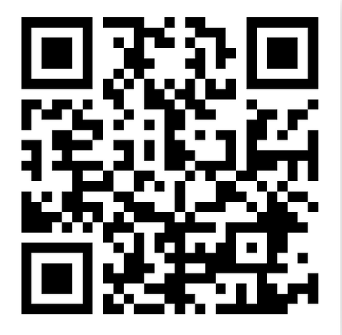
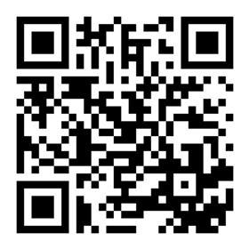
History GCSE
Revision Timetable 2022-23
In here you will find a step-by-step guide to planning your revision for both History and other subjects. At the time of receiving this there is approximately 26 weeks left until your two History exams. I have left off 3 weeks surrounding Christmas, meaning the real duration is about 29 weeks until the first exam week. The two examinations you will be sitting are as follows;
Paper 1 – USA/WW1 – Thursday 18th May 2023 (AM)
Paper 2 – H&P/Elizabeth – Wednesday 7th June 2023 (PM)
This document is available on www.historyis.net
There is also a blank version on there for those people who may prefer to rearrange the content or reprint if needed
Please make use of this booklet to keep a track of your work, some of which you may have completed already. As you read how to use this timetable, please pay attention to how it is supposed to work and some possible revision strategies
It is the best we can do to provide you with a structure and materials available to help you organise.
Possible revision resources:
Your exercise books (assuming they are organised)
Teams (your lessons will be in your class Team)
www.historyis.net (revision booklets / videos)
Quizlet (see barcodes beneath)
Other AQA focused History revision websites you find
QR code for Quizlet revision cards (understanding and knowledge)
QR code for Quizlet key terms cards

Slide 2



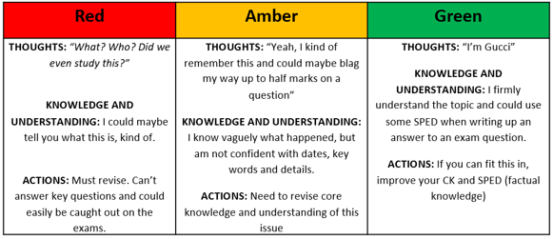
How to make the best use of your History revision timetable​
​
​
Before we begin, here are a few things you need to consider before you start using it. This revision schedule is designed to be almost complete by the time revision amplifies in other subjects. The guidance below will help you modify this revision timetable to your needs. If you find that the modifying leaves you with a completely different version then there is a blank template on www.historyis.net (along with another of the filled one as a reminder)​
​
STEP 1: IDENTIFYING:​
How many subjects will you be sitting exams in? _______ (list them below, including how many exams)​
​
___________________ How many exams in this subject? ______​
___________________ How many exams in this subject? ______​
___________________ How many exams in this subject? ______​
___________________ How many exams in this subject? ______​
___________________ How many exams in this subject? ______​
___________________ How many exams in this subject? ______​
___________________ How many exams in this subject? ______​
___________________ How many exams in this subject? ______​
___________________ How many exams in this subject? ______​
___________________ How many exams in this subject? ______​
___________________ How many exams in this subject? ______​
​
​
STEP 2: PRIORITISING:​
Are there any subjects you feel you might need to spend a bit more time on during revision? For example, are there any that you didn’t do quite so well on in your mocks, or subjects that you are intending to study at A-level?​
​
​
​
​
​
​
STEP 3: TIME MANAGEMENT:​
Do you have any commitments during the week that are going to make revision difficult on some days? For example, if you play football, what time do you play and for how long?​
​
Sunday: ____________________​
Monday: ____________________​
Tuesday: ____________________​
Wednesday: _________________​
Thursday: ___________________​
Friday: _____________________​
Saturday: ___________________
As you guys already know, there are three units that you will be examined on in your History GCSE this year. These are;​​
​​
P1: Section A: America 1920-1973: Opportunity and Equality​​
P1: Section B: Conflict and tension: The First World War 1894-1918 ​​
P2: Section A: Health and the people;c1000 to the present day​
P2: Section B: Elizabethan England, c.1568-1603
​
How to use the table​
The 4 units outlined above are spread over 18 weeks of revision with 6-7 items per week (some bigger, some smaller). There is a 6-week blank page in the final few weeks before exam season to revise the final unit– but keep in mind that ALL subjects will be pressuring you by this point. ​You may want to start revising Elizabeth earlier
​
Use the left column to RAG each item based on the scale below and then, once revised, RAG it to the right. ​
​
​
​
​
​
​
​
​
​
​
2. The top rows tell you the start date of that week (like in your planner) and how many weeks are left until your exams begin. If you get in from school at 3:30pm, give yourself time to chill out and relax before starting work. Rest your brain and start your revision at 4pm. So, your first revision slot might be from;​
​
4.00pm - 4.50pm. Take a ten-minute break after this and start your next revision slot at 5.00pm and study until 5.40pm – if you fancy a second shorter session.​
​
3. It is up to you to decide when and what you will study. The times on the revision timetable are just as an example. If you have football on a Thursday evening at 4.00pm, for example, you can just shade/cross out revision slots then and reschedule them for another day.​
4. Study times at the weekends may be different. You might want to do some work in the mornings instead (your brain is very capable in the mornings), so there are separate time slots for you to fill in here. You can also use the weekends/half terms to catch up from weeks where you were unable to complete the required tasks!​
​
Revision…REMEMBER​
No more than 50 minutes non-stop revision at a time! ​
Don’t overdo it! Revising solidly from 4pm until midnight will exhaust you and your brain! A tired brain can’t learn! Make sure you get plenty of sleep and have a proper break for meals.​
Take a ten-minute break in between sessions; get a drink, stretch your legs and give your brain a break!​
Be proactive! Simply reading notes is no help to you – makes notes, mind map and use colours! Keep your brain busy! Don’t let it switch off!​
Every person is different, so every revision timetable is different – you need to work out what is best for YOU!​
Do NOT let yourself be distracted by unimportant things whilst revising or it doesn’t count. Don’t fool yourself, otherwise you become the fool.

Slide 3
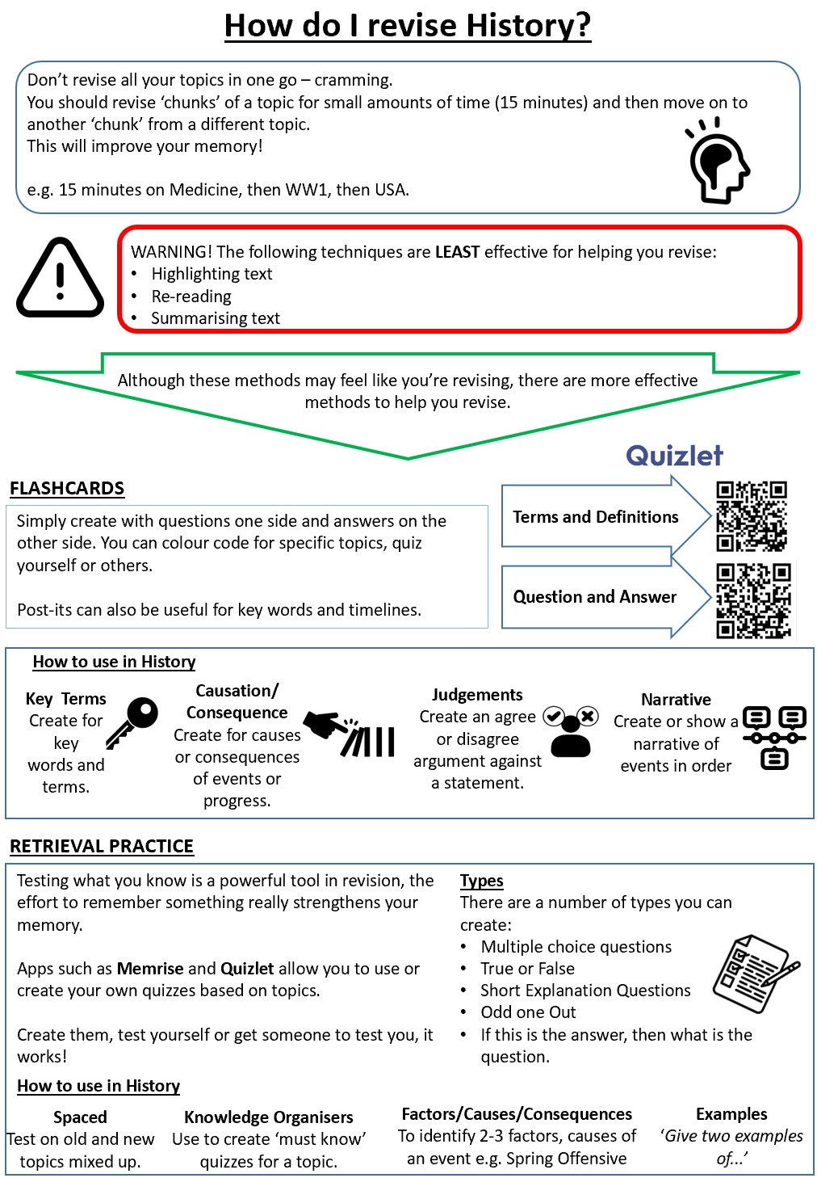
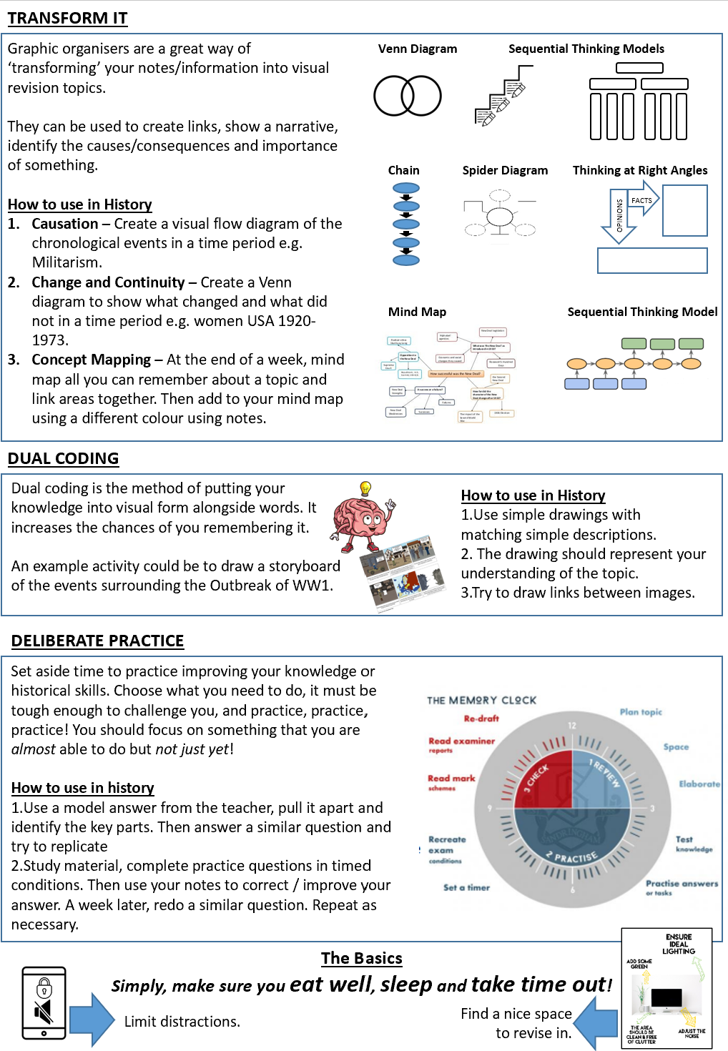

Slide 4
27 weeks to go! | Revision Timetable – PAGE 1 Exam Dates - P1 USA/WW1 – Thurs 18th May (AM) // P2 – H&P/Elizabeth – Weds 7th June (PM)
 | 14th November 2022 |  |  | 21st November 2022 |  |  | 28th November 2022 |  |  | 5th December 2022 |  |  | 12th December 2022 |  |  | 9th January 2023
 | Week 27 |  |  | Week 26 |  |  | Week 25 |  |  | Week 24 |  |  | Week 23 |  |  | Week 19
Sunday
Monday
Tuesday
Wednesday
Thursday
Friday
Saturday

Slide 5
ONLY 20 weeks to go! | Revision Timetable – PAGE 2 Exam Dates - P1 USA/WW1 – Thurs 18th May (AM) // P2 – H&P/Elizabeth – Weds 7th June (PM)
 | 16th January 2023 |  |  | 23rd January 2023 |  |  | 30th January 2023 |  |  | 6th February 2023 |  |  | 13th February 2023 |  |  | 20th February 2023
 | Week 18 |  |  | Week 17 |  |  | Week 16 |  |  | Week 15 |  |  | Week 14 |  |  | Week 13
Sunday
Monday
Tuesday
Wednesday
Thursday
Friday
Saturday

Slide 6
ONLY 12 weeks to go! | Revision Timetable – PAGE 3 Exam Dates - P1 USA/WW1 – Thurs 18th May (AM) // P2 – H&P/Elizabeth – Weds 7th June (PM)
 | 27th February 2023 |  |  | 6th March 2023 |  |  | 13th March 2023 |  |  | 20th March 2023 |  |  | 27th March 2023 |  |  | 3rd April 2023
 | Week 12 |  |  | Week 11 |  |  | Week 10 |  |  | Week 9 |  |  | Week 8 |  |  | Week 7
Sunday
Monday
Tuesday
Wednesday
Thursday
Friday
Saturday

Slide 7
ONLY 6 weeks to go! | Revision Timetable – PAGE 4 (Lizzy focused) Exam Dates - P1 USA/WW1 – Thurs 18th May (AM) // P2 – H&P/Elizabeth – Weds 7th June (PM)
 | 10th April 2023 |  |  | 17th April 2023 |  |  | 24th April 2023 |  |  | 1st May 2023 |  |  | 8th May 2023 |  |  | 15th May 2023
 | Week 6 |  |  | Week 5 |  |  | Week 4 |  |  | Week 3 |  |  | Week 2 |  |  | SO IT BEGINS
Sunday
Monday
Tuesday
Wednesday
Thursday
Friday
Saturday

